Slide 1
Identifying HARPed Loans
January 2016

Slide 2
INTRODUCTION
1
Importance of identifying HARP loans
Loans that have been refinanced through the Home Affordable Refinance Program (HARP) generally prepay slower than other refinance loans that have undergone full underwriting. As a streamline refinance program, HARP generally made only minimal requirements of borrowers, and such borrowers may have trouble qualifying for regular refinances.
2
Existing algorithms for identifying HARPed Loans
Prior to August 2013:
This is the period prior to Freddie Mac providing loan-level credit information for fully underwritten mortgages
MI matches were used to identify potential HARPed loans with OLTV > 80% and loan purpose as Refi-NCO (No Cash-out)
Although HARP targets with LTVs > 80%, loans with lower OLTVs are counted as part of HARP because the Agencies essentially suspended their streamline refi programs after the financial crisis and currently rely on the HARP program for all streamline processing
After August 2013:
New Freddie Mac and Fannie Mae loan-level credit information are used to identify 30-year fixed –rate HARP loans by mapping the credit dataset to the standard database without restrictions on the LTV ratio
The credit data set has about a one year lag, which means that recently originated loans cannot be identified as being HARPed or not using the current algorithm

Slide 3
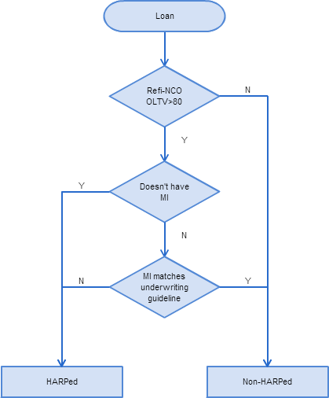
EXISTING ALGORITHM I MI Matching Method
Three Step Mapping
Step 1: The loan should be originated after June 2009 as a refi-NCO loan, with Origination LTV >80%. Otherwise, it’s Non-HARPed.
Step 2: If the loan doesn’t have MI, we match it as HARPed loan;
If not, go to step 3.
Step 3: For the loans that potentially carry over MI check whether MI matches current underwriting guidelines. If there’s no match, then it’s a HARPed loan.
Cons
Cannot match loans with OLTV equal or lower than 80%.
Highly sensitive to the correctness of MI underwriting guidelines.

Slide 4
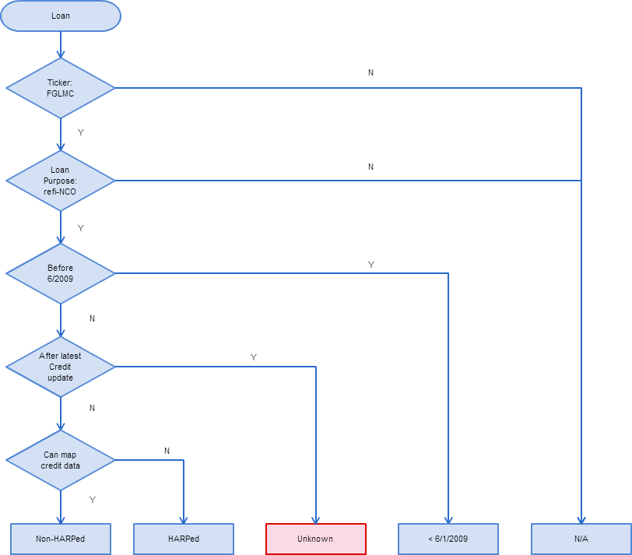
EXISTING ALGORITHM II Credit Dataset Mapping Method
Credit Data Mapping
No restrictions on OLTV > 80%.
More accurate as there is no dependency on MI underwriting criteria.
Cons
The credit data set has about a one year lag, meaning we don’t have the most recent origination data. Consequently, we have to mark the HARP status as unknown for recently (within the last year) originated loans.
Let’s review the diagram again

Slide 5
EXISTING ALGORITHM II Results from the Credit Dataset Mapping Method
Pre-HARP
HARPed
Non-HARPed
Non-eligible: Purchas, refi-CO
The blue area can be consider as non-HARPed loans; brown area is HARPed loans percentage.
Red area is the loans originated within the most recent year. The credit dataset has a gap on this area.
Need to improve the mapping for the red area.

Slide 6
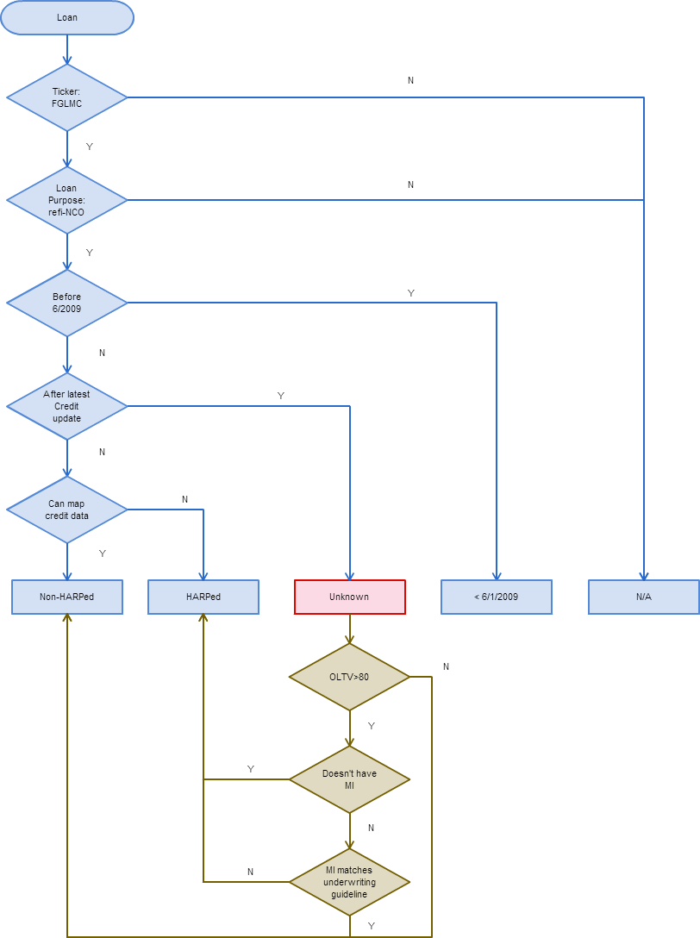
ENHANCED ALGORITHM
Asof
Algorithm I
2009.01
...
2014.01
2016.01
120
Mapped Data | Un-mapped Data
Mapped Data | Un-mapped Data
OLTV
One-year gap, unable to map recent year HARP loans.
80
...
30
Asof
Algorithm II
2009.01
...
2014.01
2016.01
120
Mapped Data | Mapped Data
Un-mapped Data | Un-mapped Data
OLTV
80
...
Unable to map HARP loans with LTV <= 80.
30
Asof
Enhanced Algo.
2009.01
...
2014.01
2016.01
120
Mapped Data | Mapped Data
Mapped Data | Un-mapped Data
Integrate algo II into algo I for the unknown one year gap.
OLTV
80
...
30

Slide 7
ENHANCED ALGORITHM Result
Pre-HARP
HARPed
Non-HARPed
N/A: Purchas, refi-CO
Using the Enhanced Algorithm
Pre-HARP
HARPed
Non-HARPed
N/A: Purchas, refi-CO

Slide 8
SANITY CHECK #1
H1
There is a bias between FHLMC and FNMA (FNMA: include all refis; FHLMC exclude cash-outs)
Not true
We did a simple test using FHL data, run through the algorithm for both FNMA(not specified refi-NCO) and FHL(specified refi-NCO), loan count number for HARPed loans are identical for both old algorithm and new algorithm.
Credit Data Mapping Algo.
As all refi-CO loans are full documented, the new algorithm has the ability to provide a non-biased HARPed loan identification process.

Slide 9
Hypotheses Test I
H1
There is a bias between FHL/FNMA (refi or refi NCO/CO)
Not true
We did a simple test using FHL data, run through the algorithm for both FNMA(not specified refi-NCO) and FHL(specified refi-NCO), loan count number for HARPed loans are identical for both old algorithm and new algorithm.
MI Mapping Algo.
Results from the old algorithm are also identical for both FNMA(not specified refi-NCO) and FHL(specified refi-NCO) scenarios.

Slide 10
Hypotheses Test II
H2
There is a bias between the two algorithms
True
By plotting the loan count number for HARPed loans using the two different algorithms, we can see a systematic bias between them.
The average ratio (New algorithm / Old algorithm) is 2. So in our enhanced algorithm, we need to adjust the old algorithm by the ratio number for the most recent year period. Presumably this is because we’re not counting loans with LTVs < 80% in the MI algorithm.

